Slide 1
Tympe
CSSI final project

Slide 2
Introduction
Front End Developers: Daniel Marin & Sonny Pizzo
Back End Developers: Logan Schlick & Kyle Rimando
Advisor: Shane Ghuste

Slide 3
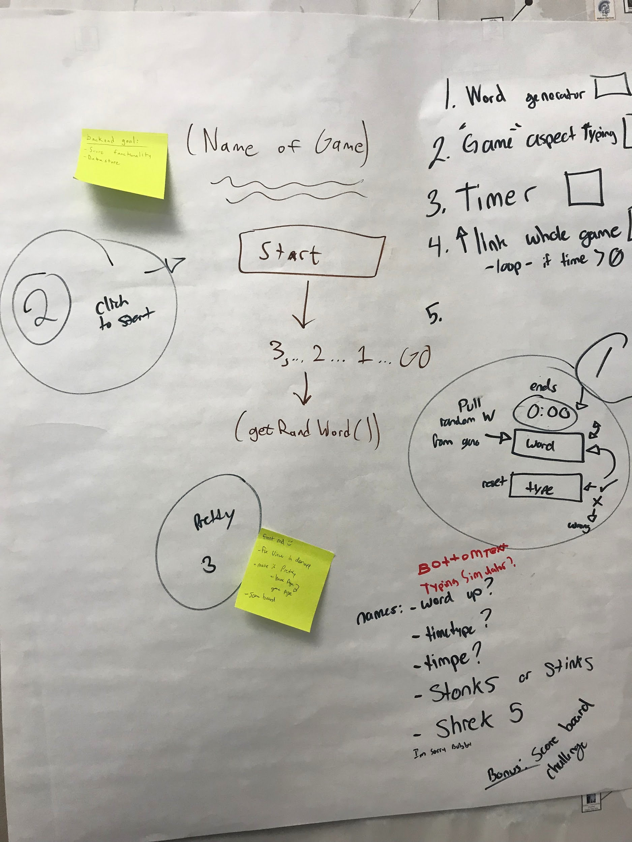
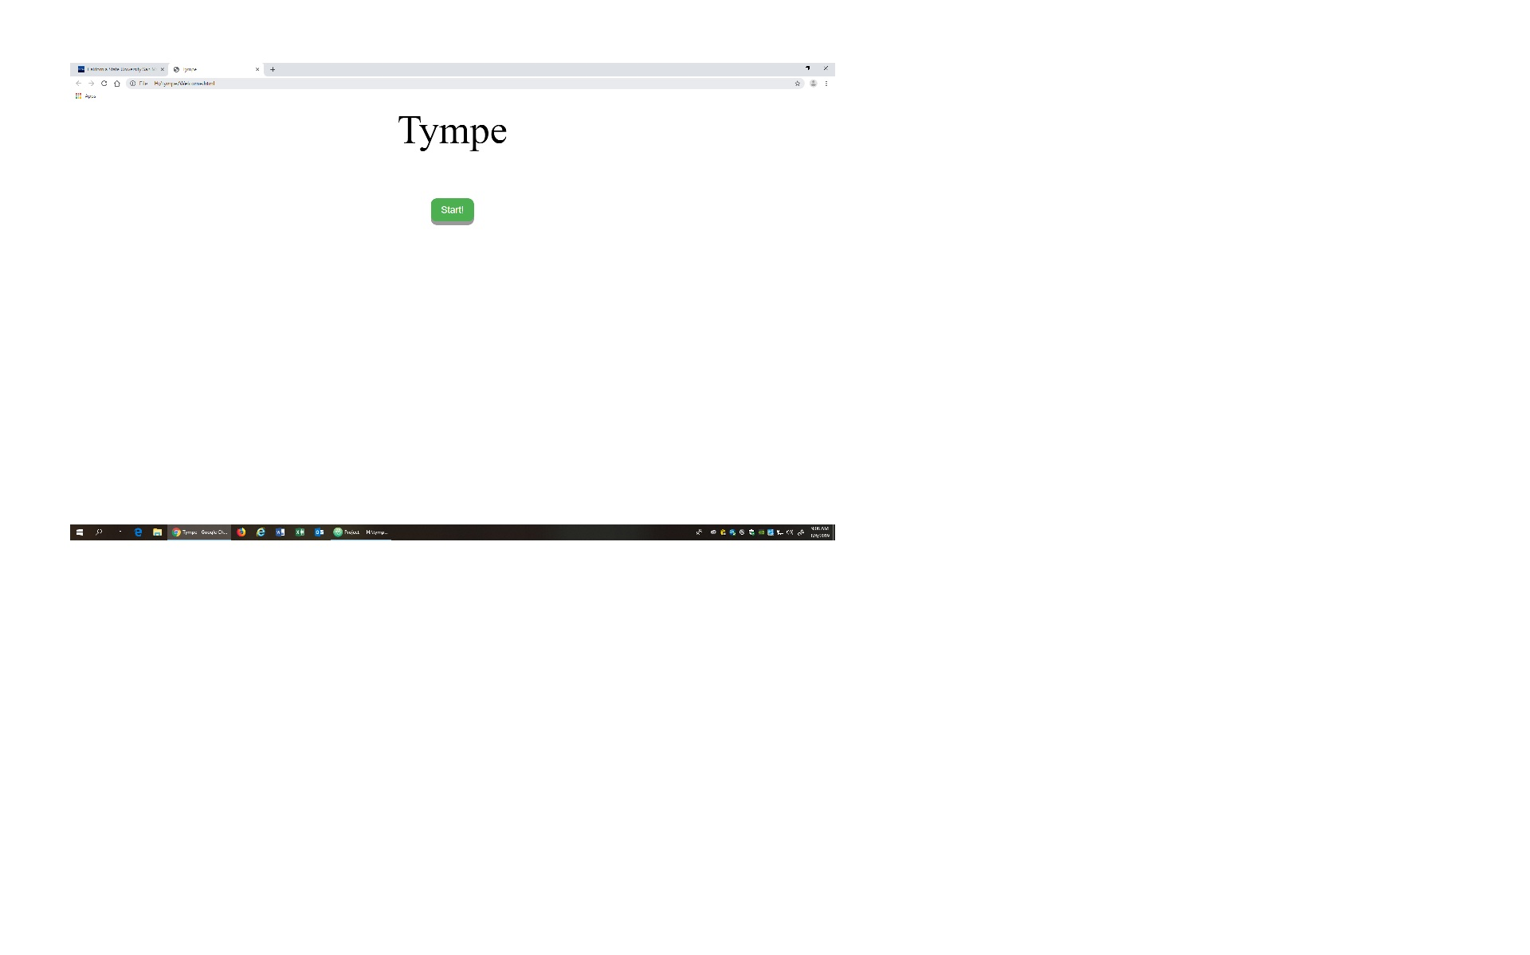
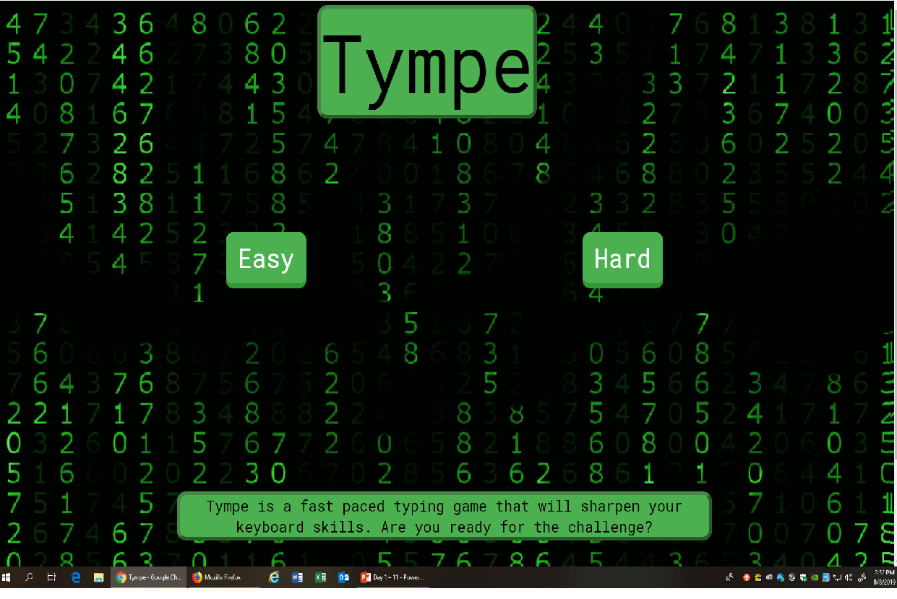
What is Tympe?
Tympe is a word typing game developed to sharpen your keyboard skills through a timed challenge.
Easy mode - basic computer users
Hard mode - implements coding language directed toward CS

Slide 4
Overview
Displays a random word on the screen.
Player must type the word in the textbox.
If the word is correct, points are awarded to the player and the textbox is cleared.
After one minute, the game ends.
Final score is a measure of the player’s typed characters per minute.

Slide 5
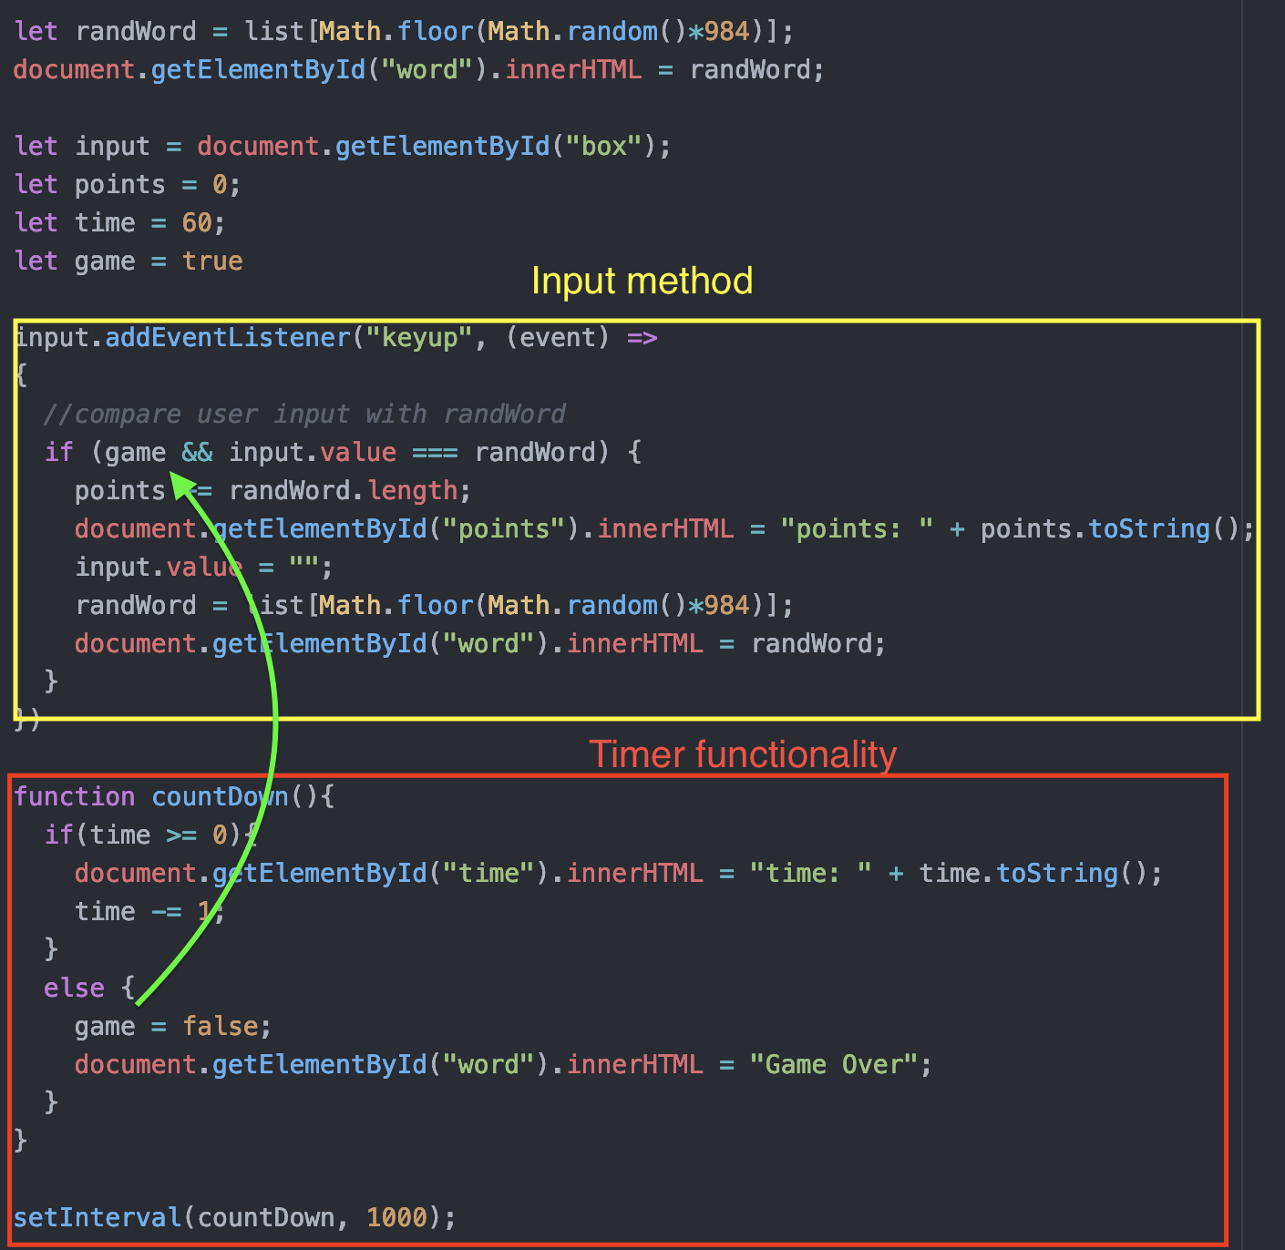
Code
Every time a key is released, the game compares the value of the input field with the target word.
Once the timer runs out, it becomes impossible to gain points.

Slide 6
Demo time
https://academic-era-247918.appspot.com

Slide 7
Summary
Shout outs
Skills gained
CSSI experience

